Slide 1
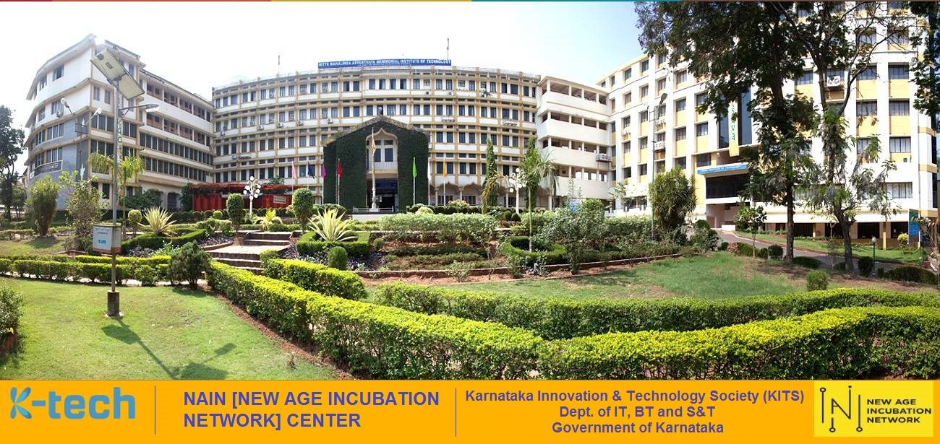
Department of Mechanical Engineering
Welcome you all to the
One Day Skill Development Program
On
“Design of Experiment using AI and ML”
Venue: Phalguni Seminar Hall
Date: 16-02-2022
Time: 9.30 A.M.

