Slide 1
SOLmate : PROJECT SYNOPSIS

Slide 2
RURAL INDIA’s PLIGHT
20% of villages still without electricity
Frequent power cuts in rural India
Limited hours of power supply
Power fluctuations – often & wide
Data/internet reach is poor
Mobile signal strength is sparse and sparing
Till now only specific purpose computing available – School or Citizen services

Slide 3
Computing Device Shortcomings
Power Hungry:- Battery charge does not last long
Resource Hungry:- Battery takes longer time to charge
Capacity Hungry:- Batteries require regular charging
Software Stranglehold: OS & Basic Office software costs
License Raj: Cloud facilities to DB are all licensed & to be subscribed.
Battery low on charge

Slide 4
Our Solution : SOLmate
Solar Powered Laptop
Clean and Free Renewable energy
Considerable financial savings
Reduced dependency on power grid
Less maintenance and low cost of operation

Slide 5
PRODUCT FEATURES & CONCEPT
Solar Powered
Portable
Full-day Operation
Open Source Software
All-in-One Computer with Entertainment box
Network enabled 4G/WiFi
Designed and Made in INDIA

Slide 6
SOLmate Product Offering
24 hour battery backup – One Full day of operation
More than 1 Lakh documents and books can be stored permanently
With 4G & Wireless LAN, can watch High Definition (HD) movie
Has Television interface for Cable TV viewing
More than 100 full feature movies can be stored for viewing.

Slide 7
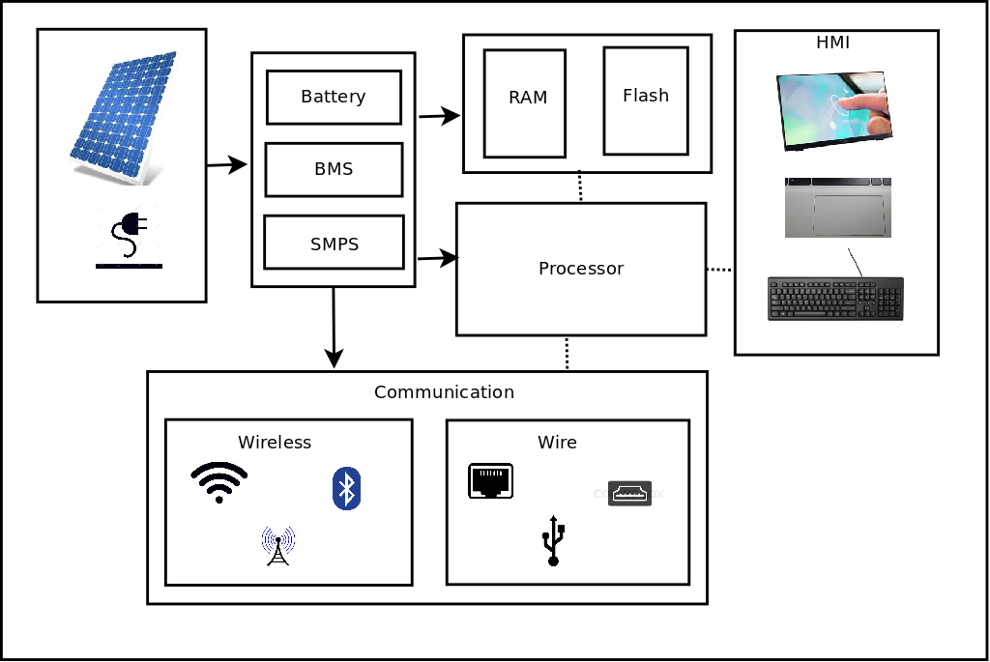
SOLmate HARDWARE BLOCK DIAGRAM

Slide 8
SOLmate: HARDWARE ARCHITECTURE
Shortlisted Processors are
Snapdragon (from Qualcomm) MSM 8909
ARM Cortex-A7 Quad-core 1.1 GHz
Freescale i.mx8
ARM Cortex-A53 Quad-core (1.2 GHz) + Cortex A-72 Dual-core (1.8 GHz)
Additional Peripherals are
Audio & Camera interfaces

Slide 9
COMMUNICATION & SOFTWARE UTILITIES
Multiple modes of connectivity
Ethernet – For fixed line broadband
WiFi – For wireless broadband
3G/4G – For mobile broadband
Bluetooth
Video conferencing & calling feasible
Includes standard softwares for work
Libreoffice / KingOffice
Chrome / Firefox browser
VLC media player
Connect to projector
View streamed education content
Connect to multimedia box (Set top box)
USB ports for peripheral devices

Slide 10
SOLmate: SYSTEM SOFTWARE
Multiple Operating Systems
Linux 4.xx kernel + customized drivers
Android (supported version for chosen processor)
Microsoft Windows (needs exploration and feasibility)
Application Development Kit & SDK for SolMate.

Slide 11
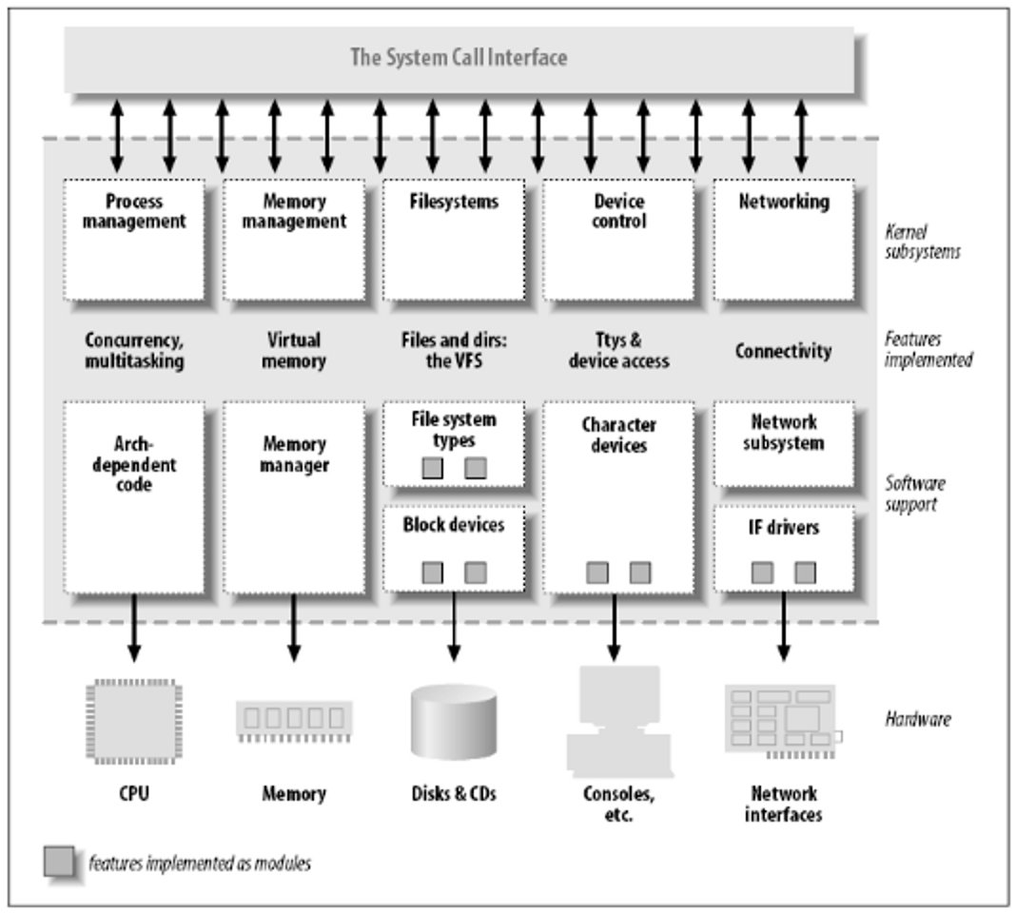
SOLmate: Linux Kernel Architecture

Slide 12
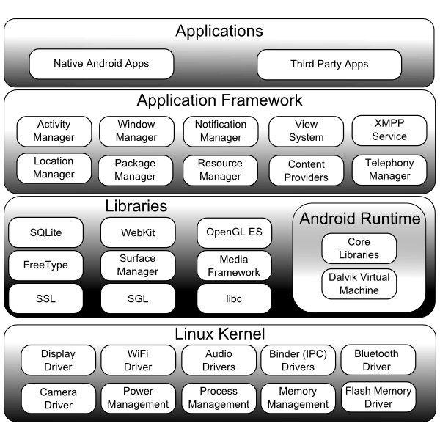
SOLmate: Android System Architecture

Slide 13
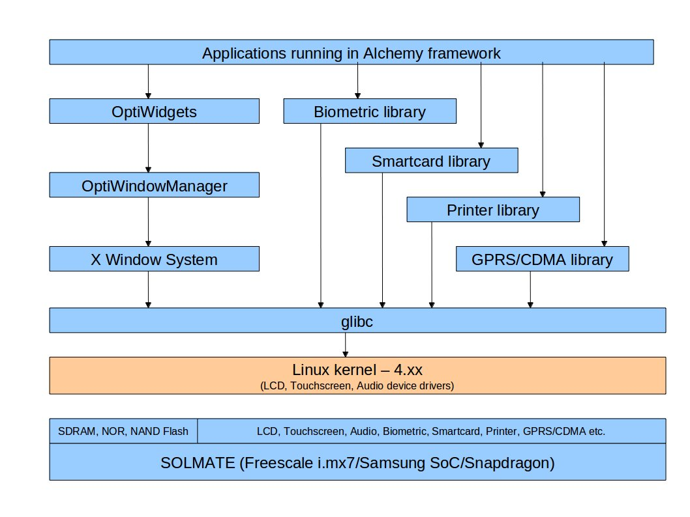
SOLmate: System Software Architecture

Slide 14
SOLmate: Applications/Software Stack
e-Government Digital Services
Anganwadi Software
Land Survey and Mapping using Drones Services (NMAMIT startup)
Web Ratna awarding winning APMC software & eMagazine
MicroATM & Banking applications
eKYC and Aadhaar Enabled services
NIC hosted eGovernment services

Slide 15
PRODUCT DEVELOPMENT LIFE CYCLE
Define Specification
Hardware Design
Firmware Development
Software Development
Hardware Prototype
System Architecture Design
Testing & Validation
Design for Production
Product Support & Manufacturing

Slide 16
PROJECT TIMELINES
Evaluation
Component Identification & Evaluation
Procure Evaluation Kits
Prototype Design
PCB Design
Design & Fabrication
Component Procurement
First Prototypes
Working prototypes
SLA Prototype Plastics
Final PCB
PCB Design & Farication
Component Procurement
Production Ready
PCB
Plastics
Software Readiness
Buffer Month
MONTH
1
MONTH
2
MONTH
3
MONTH
4
MONTH
5
MONTH
6
Month 1

Slide 17
MARKETING & SALES
Product to be listed in Government e-Market place
Partnering with Enterprises / Corporates - CSR Activities
State Co-Operatives Societies
Others

Slide 18
ECO SYSTEM
Build Solutions for Use Cases like
PACS
DCCB
Co-Operatives
e-Commerce for Farmers
Plantations
Dairy Industry
Micro-Finance/Credit
Aadhaar Enabled Applications

Slide 19
THANK YOU

